Slide 1
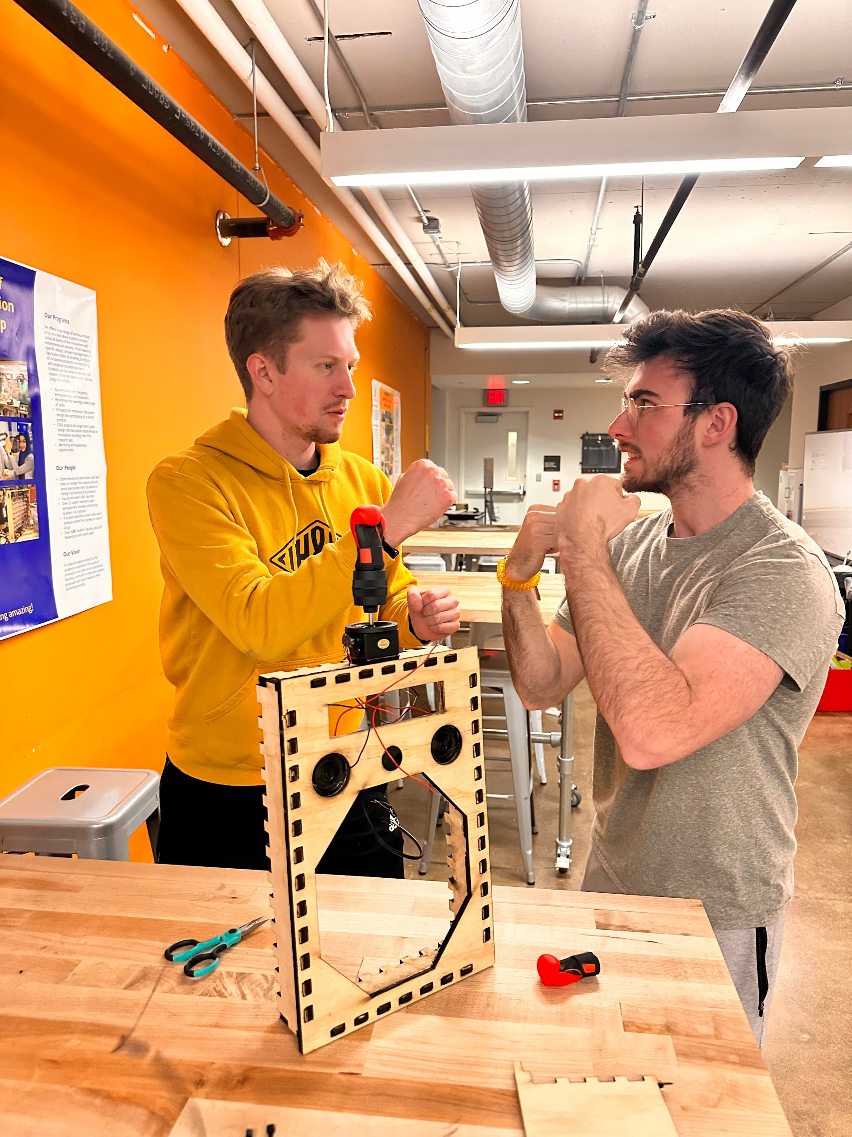
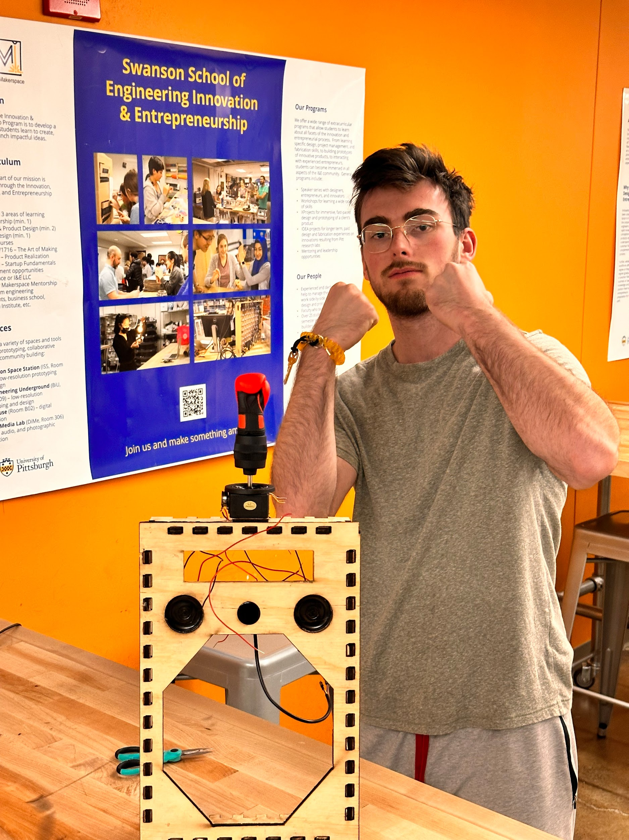
FINAL BOP-IT
Tyler Wiseman, Daniel Stoller, and Keegan Borig

Slide 2
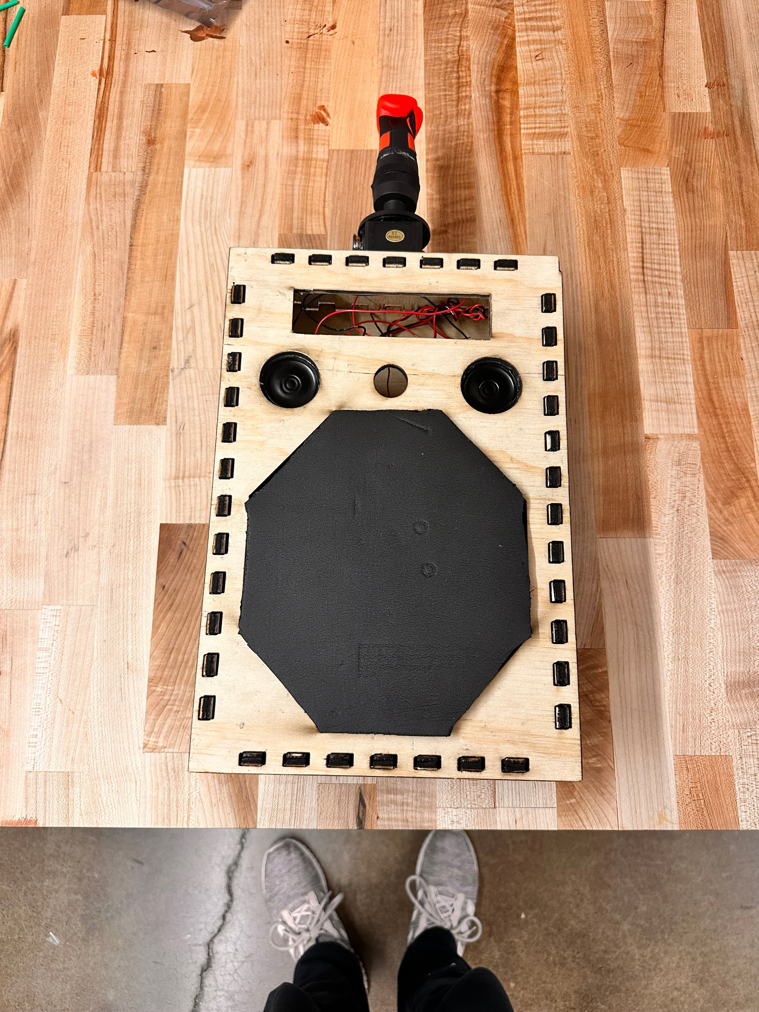
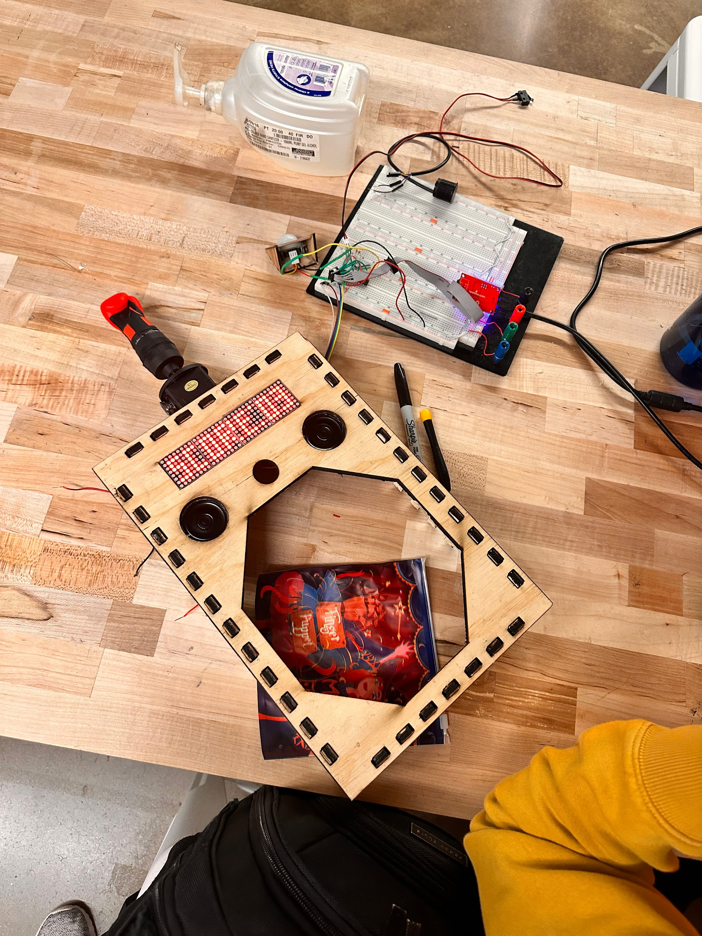
Actions Overview
ON/OFF
START GAME
PUNCH
DODGE
KICK

Slide 3
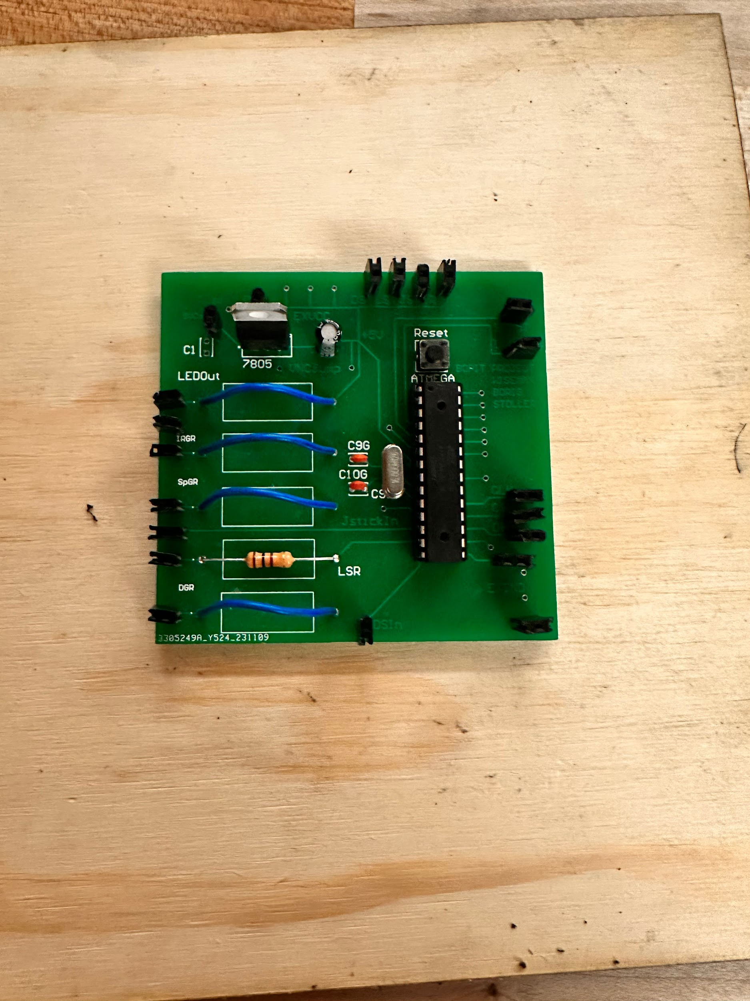
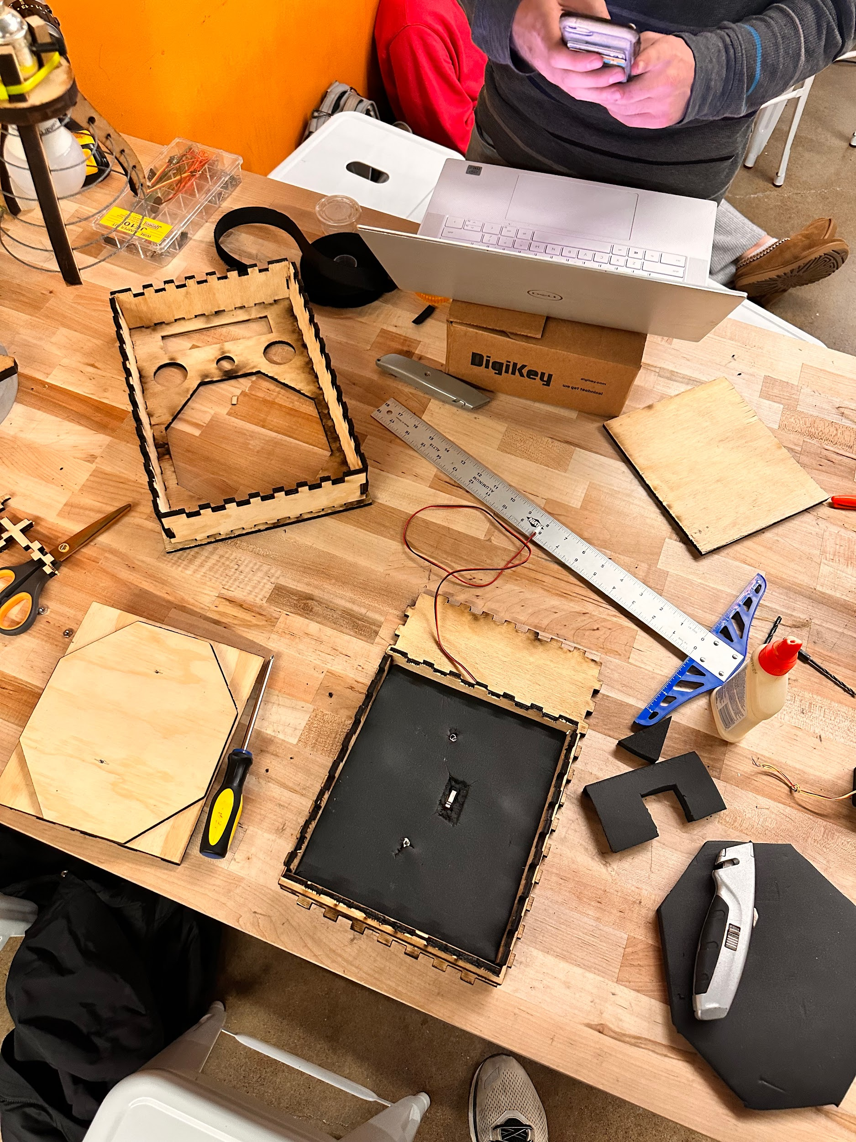
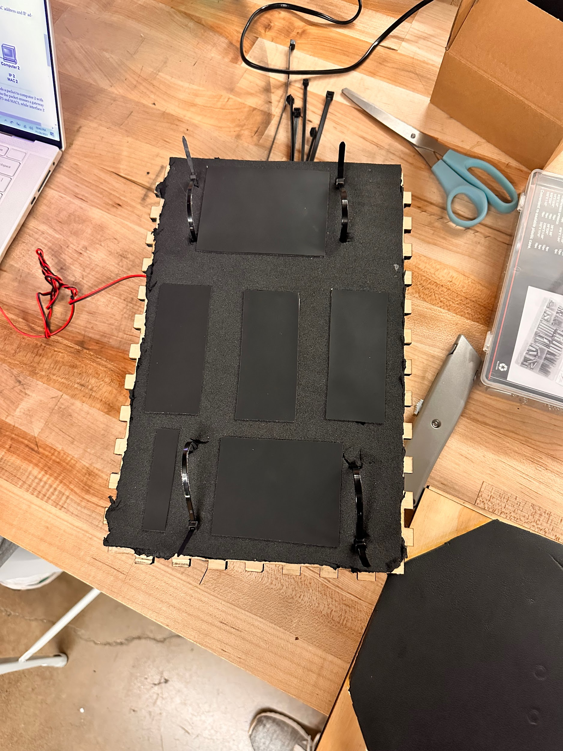
I/O + Construction
LED Display
Dual Speakers
Distance Sensor
IR/Kick Sensor
Limit Switch (Punch Sensor)
Toggle Switch (On/Off)
Foam Pasding
Velcro Straps

Slide 4
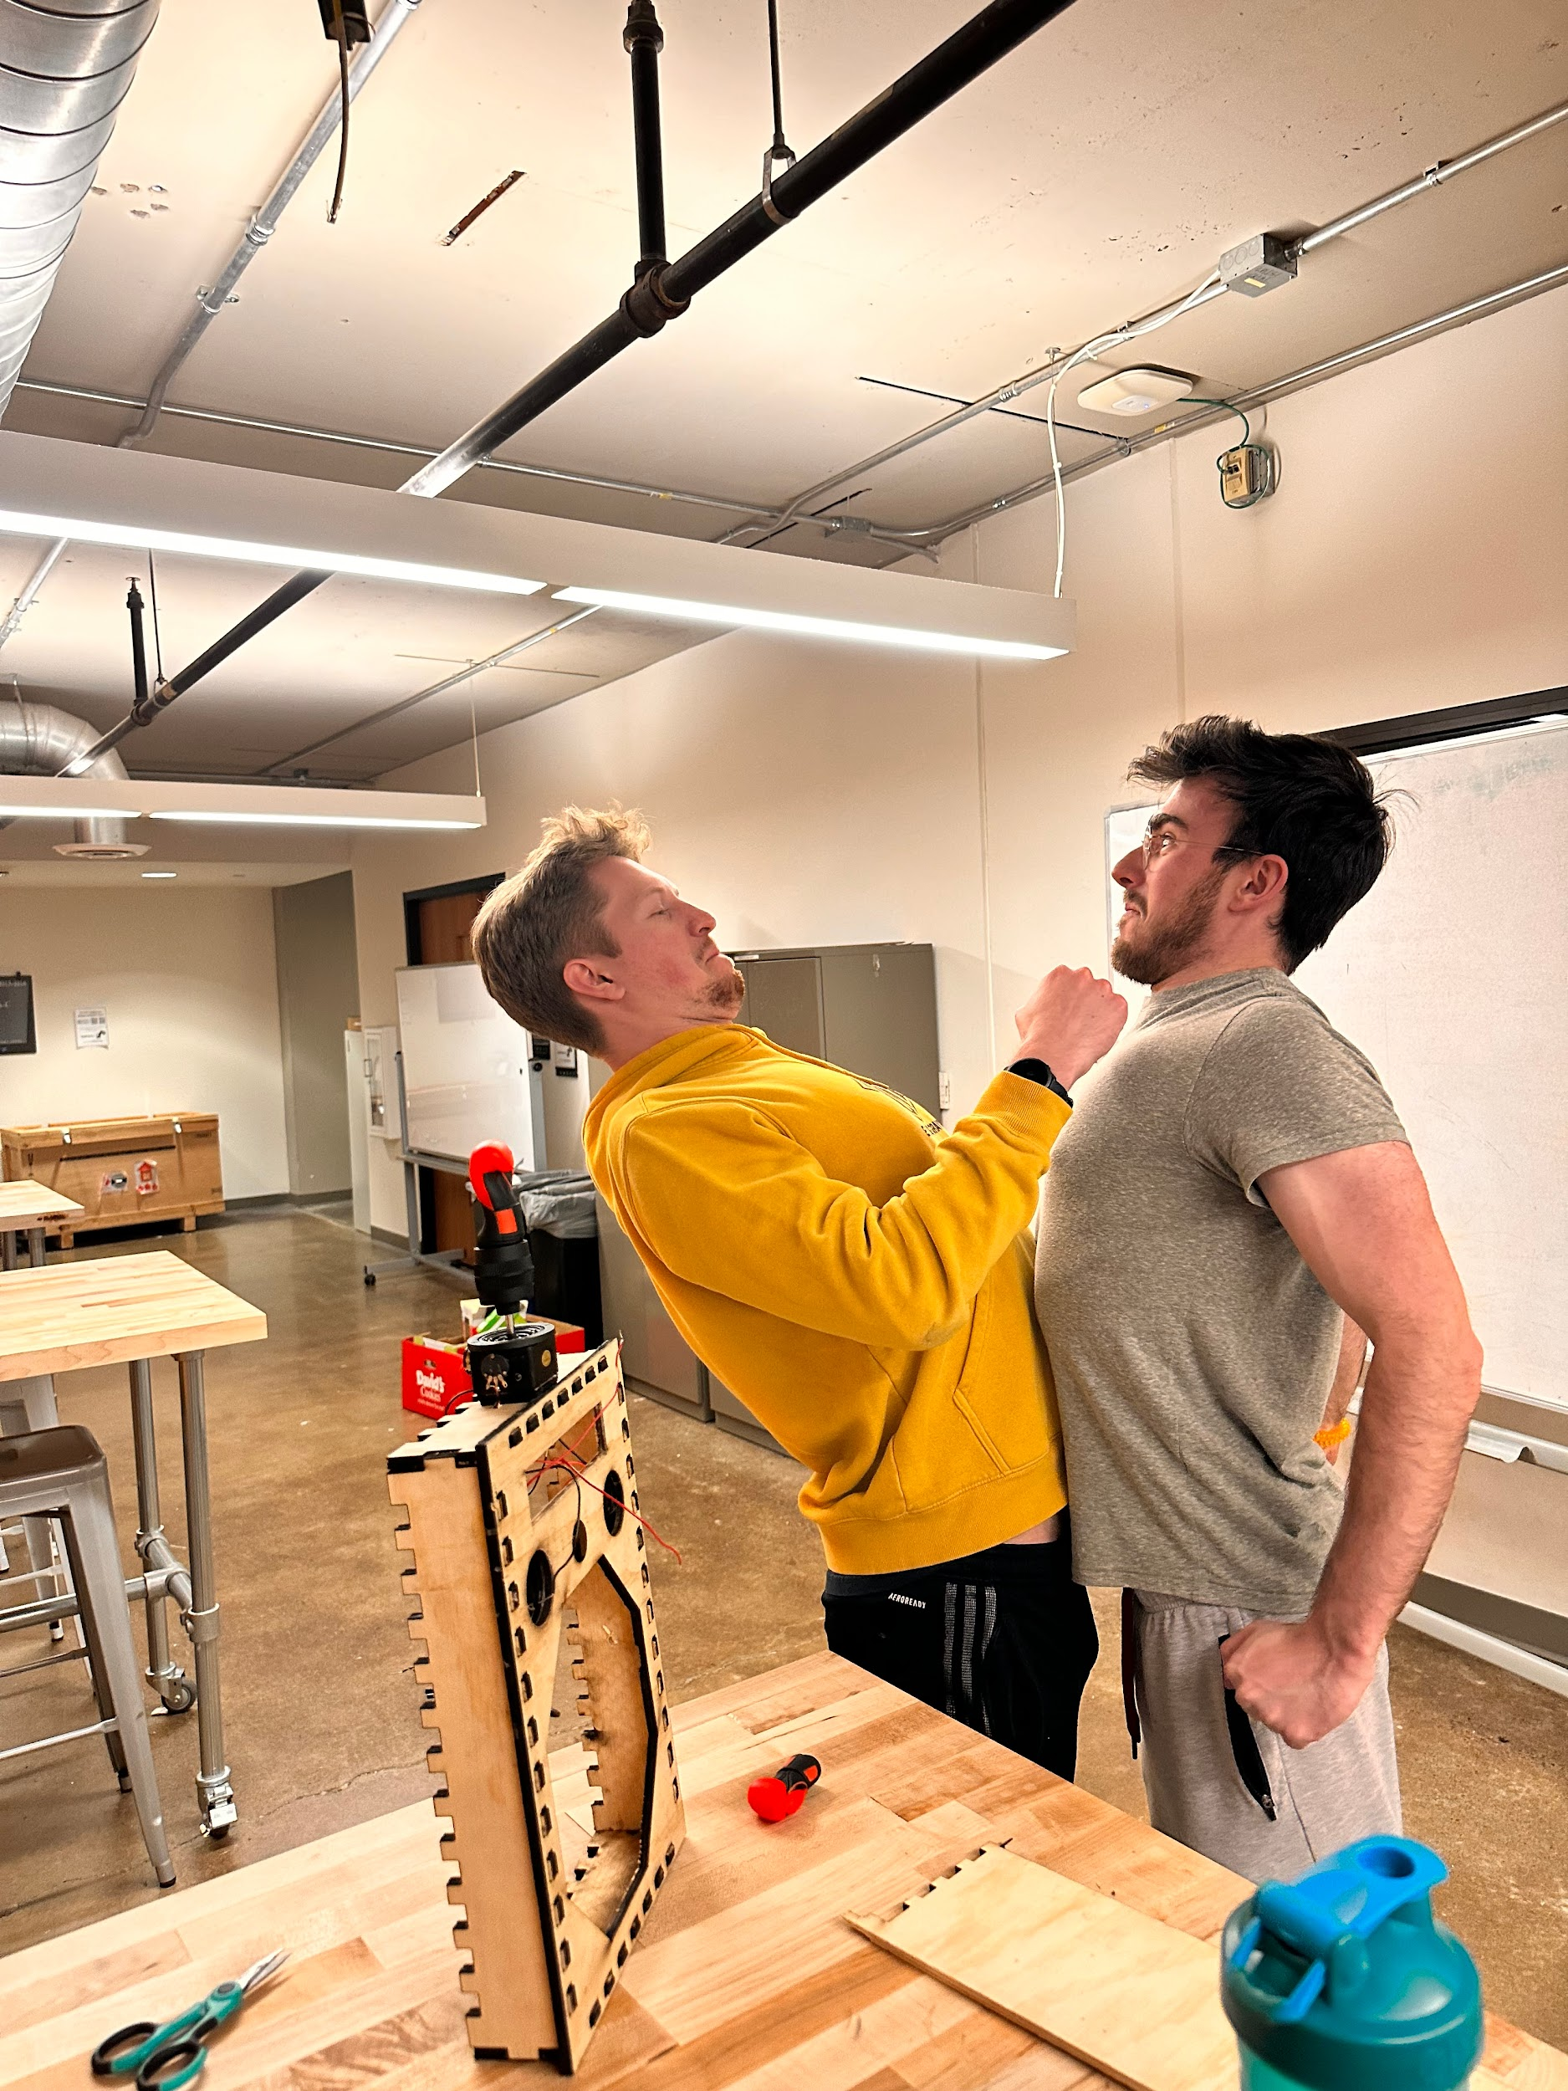
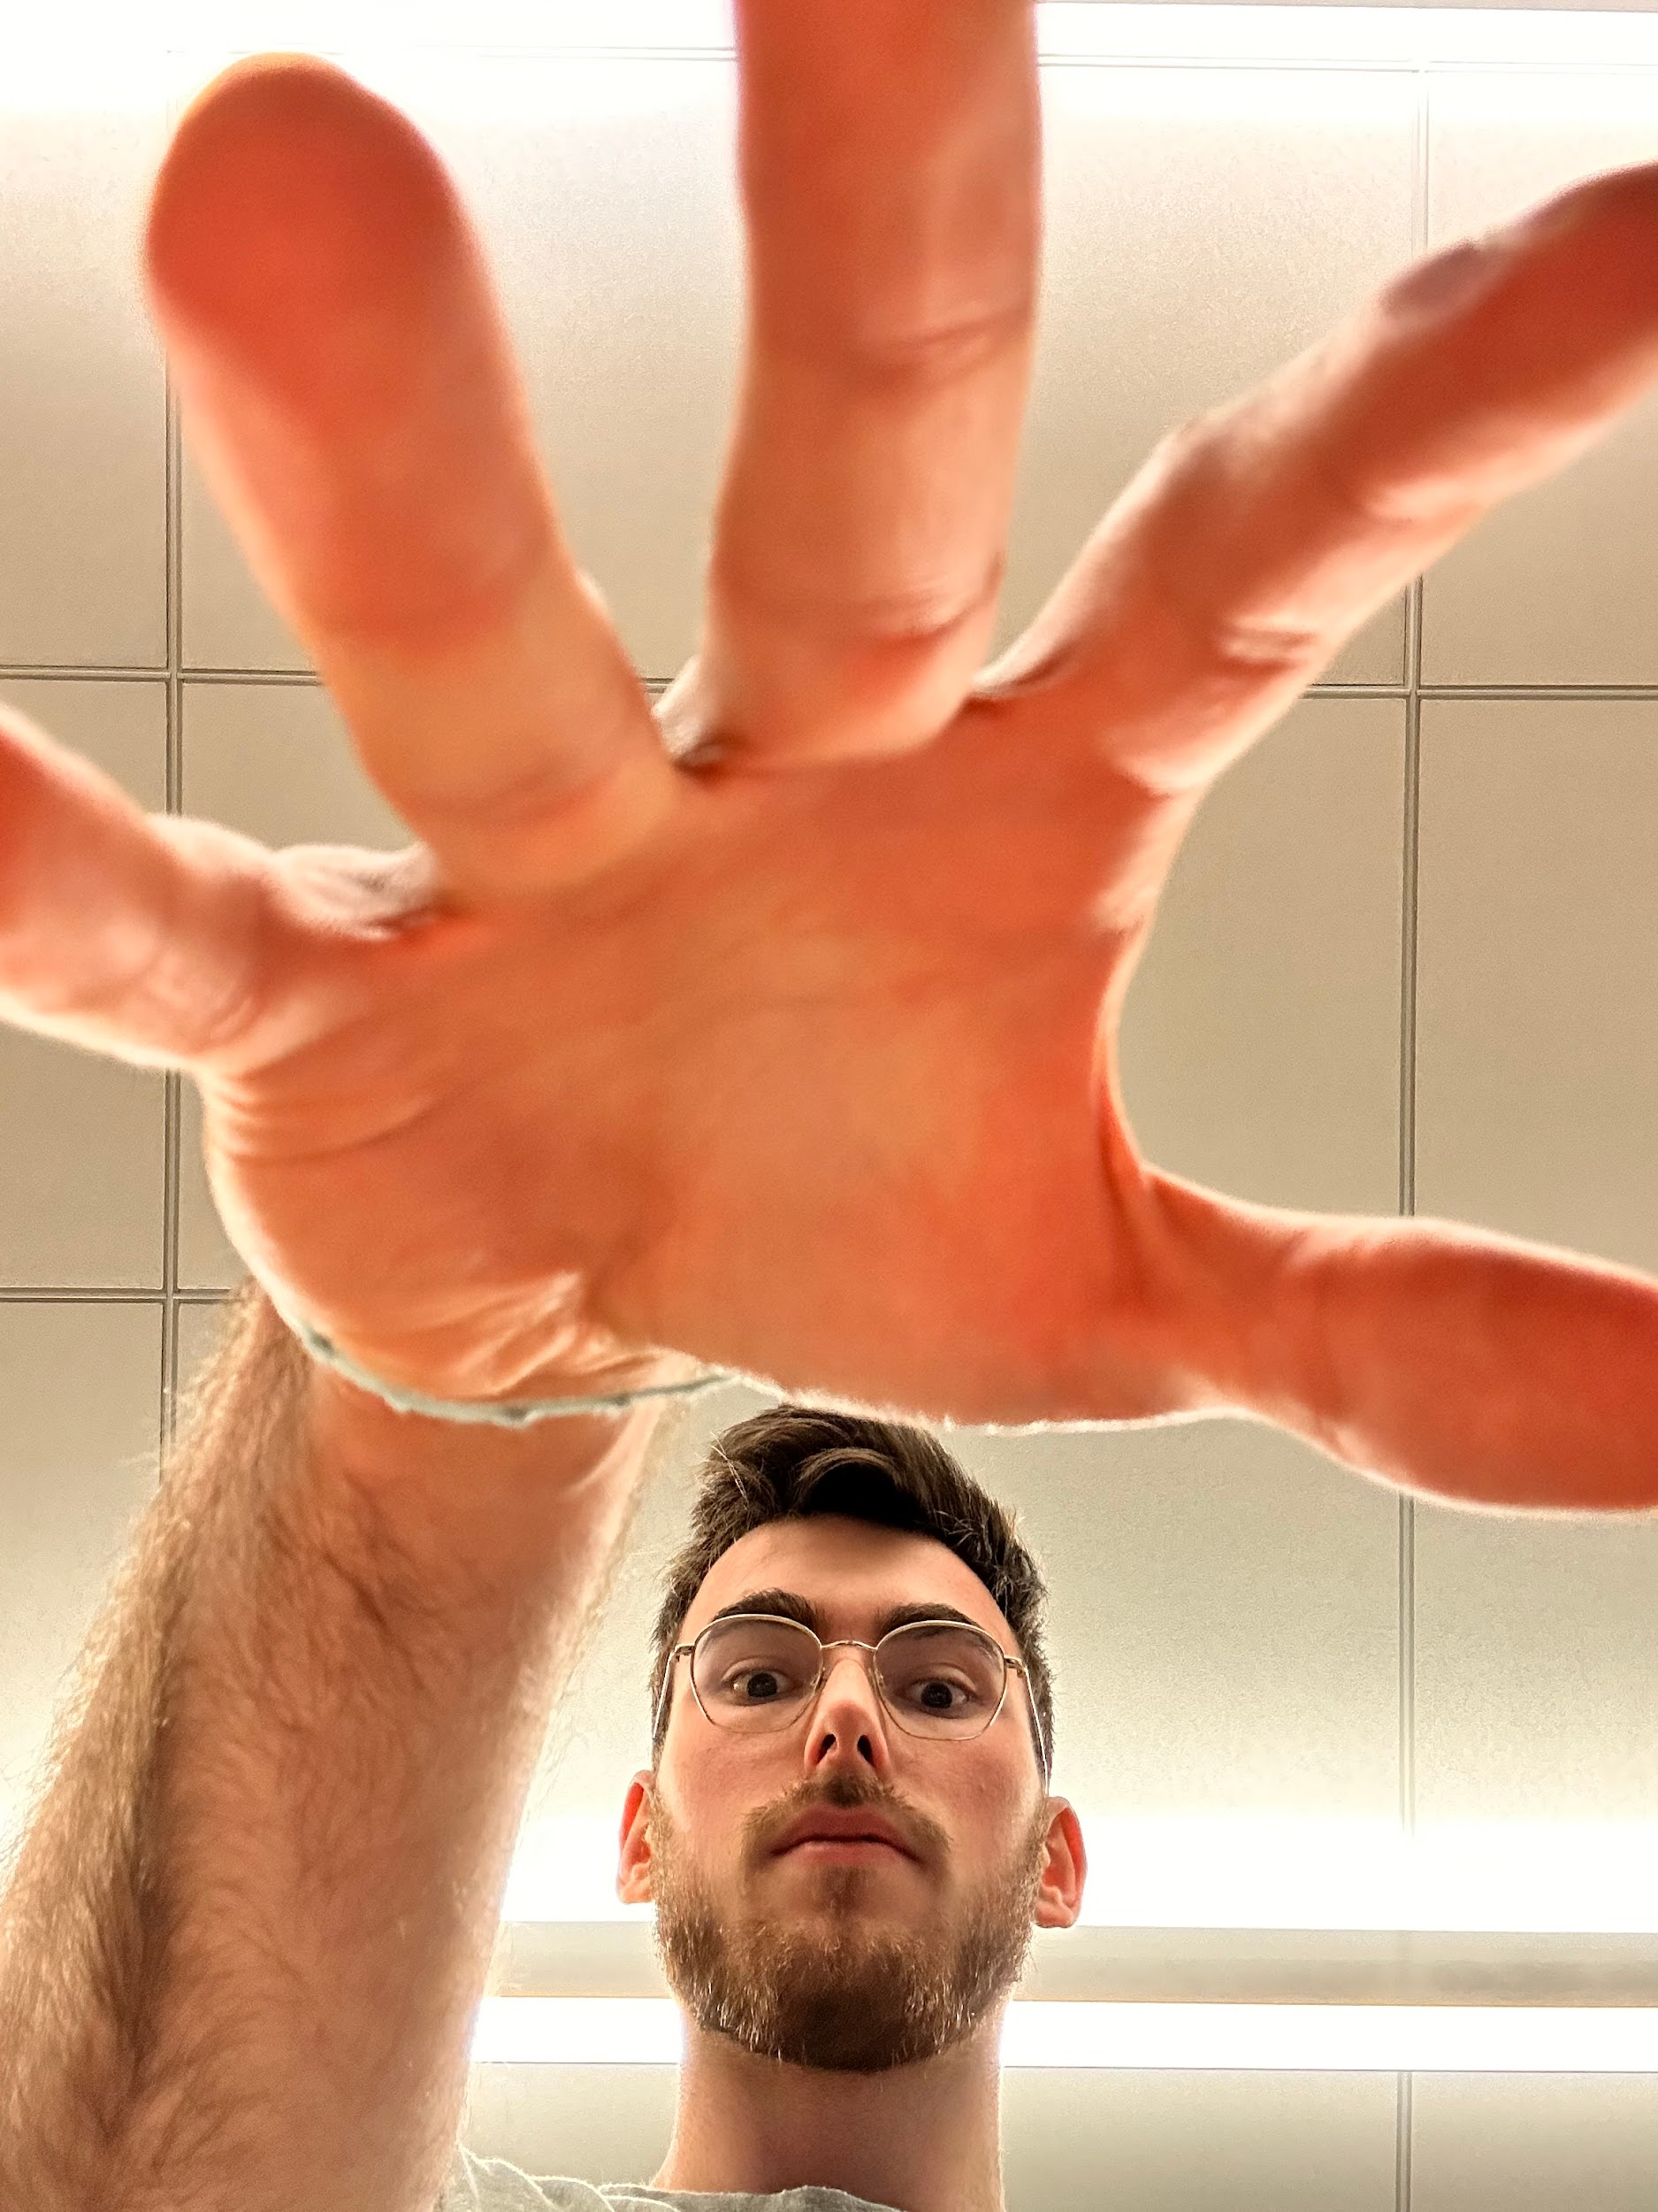
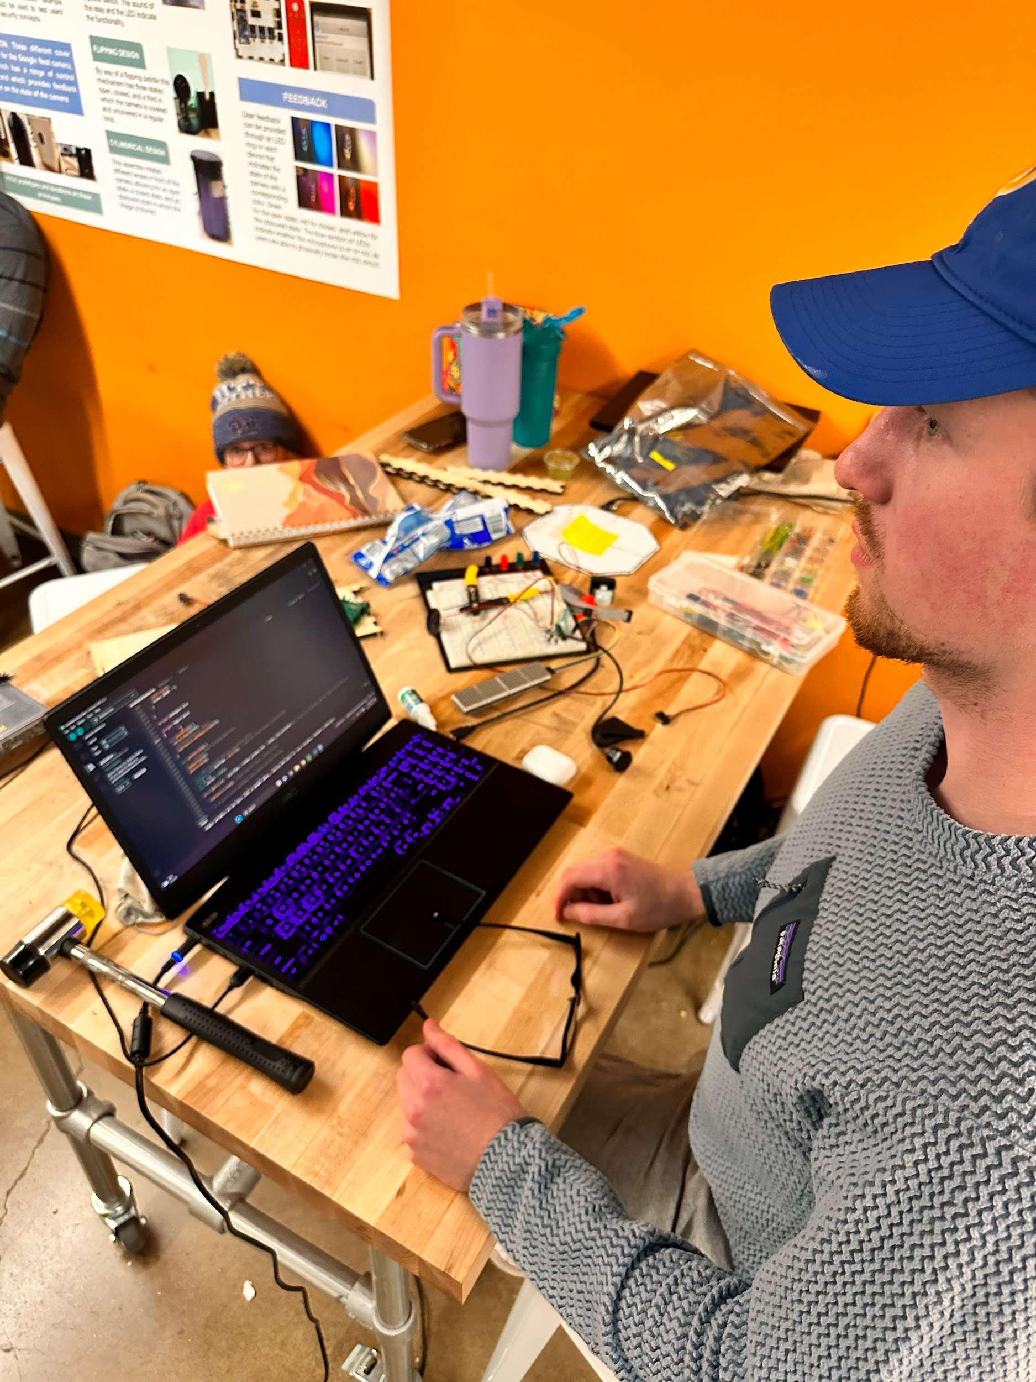
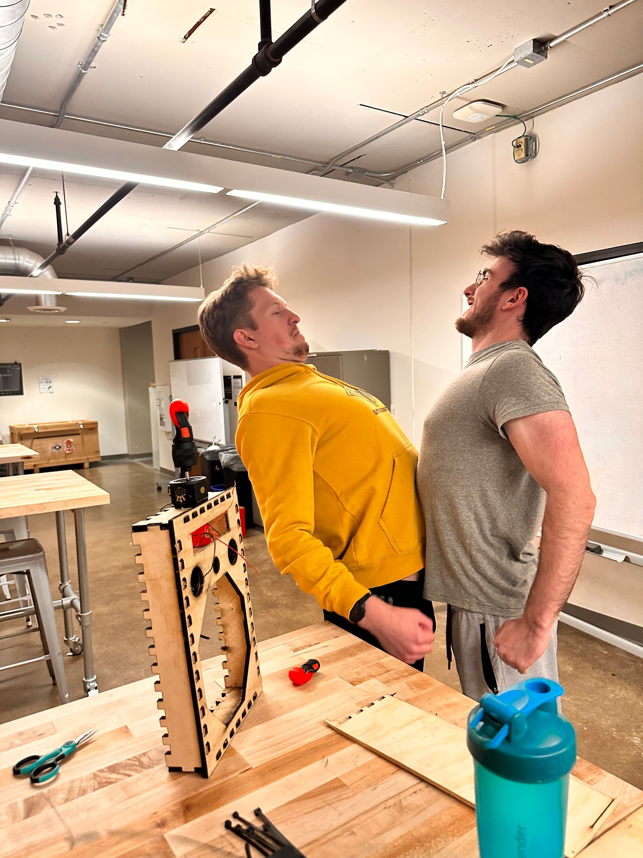
END

